Slide 1

Dr.seq2
[Step2_ExpMat]
——Parameters in config file

Slide 2
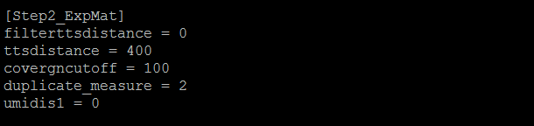
Parameters in [Step2_ExpMat]

Slide 3
Parameters in [Step2_ExpMat]
filterttsdistance = 0
#filterttsdistance: Whether discard reads far away from tts, choose from 0 or 1, set 1 to turn on this function, default is 0
ttsdistance = 400
#Default filter distance is 400bp, only take effect when filterttsdistance = 1 is set

Slide 4
Parameters in [Step2_ExpMat]
covergncutoff = 100
#Only plot cell barcodes with more than 100 (default) genes covered in the dotplots in individual-cell QC step.

Slide 5
Parameters in [Step2_ExpMat]
duplicate_measure = 2
# method to consider duplicate reads in each cell barcodes when generate expression matrix,
  1 : combine duplicate reads with same UMI and same genomic location (position and strand)
  2(default) : only consider UMI (combine duplicate reads with same UMI)
  3 : only consider genomic location only (combine duplicate reads with same genomic location)
  0 : do not remove(combine) duplicate reads (keep all duplicate reads, skip combination step)

Slide 6
Parameters in [Step2_ExpMat]
umidis1 = 0
#only take effect when duplicate_measure = 1 or 2, ignore this parameter if duplicate_measure = 0 or 3
  Set 1 :if two reads from same cell barcode have same genomic location(chrom,position,strand) and their umi distance <= 1, regard them as duplicate reads and combine them.
  Set 0 (default) : regard them as duplicate reads only when their umi distance = 0 and have genomic location.

Slide 7
Parameters in [Step2_ExpMat]
umidis1 = 0
#only take effect when duplicate_measure = 1 or 2, ignore this parameter if duplicate_measure = 0 or 3
  Set 1 :if two reads from same cell barcode have same genomic location(chrom,position,strand) and their umi distance <= 1, regard them as duplicate reads and combine them.
  Set 0 (default) : regard them as duplicate reads only when their umi distance = 0 and have genomic location.

Slide 8
Parameters in [Step2_ExpMat]
umidis1 = 0
#only take effect when duplicate_measure = 1 or 2, ignore this parameter if duplicate_measure = 0 or 3
  Set 1 :if two reads from same cell barcode have same genomic location(chrom,position,strand) and their umi distance <= 1, regard them as duplicate reads and combine them.
  Set 0 (default) : regard them as duplicate reads only when their umi distance = 0 and have genomic location.

Slide 9
Parameters in [Step2_ExpMat]
umidis1 = 0
#only take effect when duplicate_measure = 1 or 2, ignore this parameter if duplicate_measure = 0 or 3
  Set 1 :if two reads from same cell barcode have same genomic location(chrom,position,strand) and their umi distance <= 1, regard them as duplicate reads and combine them.
  Set 0 (default) : regard them as duplicate reads only when their umi distance = 0 and have genomic location.

